Slide 1
We Care - An all ailments discussion forum
By
Phani Rahul Sivalenka
Guided by
Mr. Sanjeev Kumar

Slide 2
Abstract
We Care is a web application aimed at spreading awareness about various ailments. Here users can discuss ailments that they face by adding discussion topics related to them. Users can also comment on others’/own topics. The admin can upload write-ups to create awareness among the users about these ailments. Admin can also create events for the users to participate in.

Slide 3
Functional Requirements
Providing registration for community users
Providing login and sign out capabilities
Providing password recovery facility to the user
Add/view/edit/delete topics or events capabilities according to the access rights of the user (i.e., depending on whether it is a community user or an administrator)
Providing a discussion forum to discuss various ailments under each topic
Upload/download write-ups according to the access rights of user

Slide 4
Non-functional Requirements
Security
Performance
All types of validations

Slide 5
Software/Hardware Requirements
Software Requirements
Operating Systems | Microsoft Windows 7 or above
Language/Technology | Java (jdk1.7 or above)
Front-end | HTML, CSS, JSP, JSTL, EL, JavaScript, jQuery
Application | JDBC, Servlets, MVC
Back-end | MySQL
Web Server | Apache Tomcat 7 or above
IDE | Eclipse Luna or above
Hardware Requirements
Processor | Dual core or above
RAM | 2GB or above
Hard-Disk | 50GB or above

Slide 6
Modules
Registration
Login/sign out
Topics
Events
Discussion forum
Upload(only admin)/Download write-ups

Slide 7
Users of the system
Administrator/Doctor
Community User

Slide 8
Tasks under specific modules
Module | Administrator | Community User
Registration | Static initialisation of admin | Registration for each user
Login/sign out | Logging in Forgot password Signing out | Logging in Forgot password Signing out
Topics | View/discuss any topics Delete any topic Add/edit/delete admin specific topics | Add/edit/delete user specific topics View user specific topics/all topics Discuss any topic
Events | Add/view/delete events | View events
Discussion Forum | Comment in any topic | Comment in any topic
Upload(only admin)/Download write-ups | View uploaded files Upload/download write-ups | View uploaded files Download write-ups

Slide 9
Use Case Diagram – Community User

Slide 10
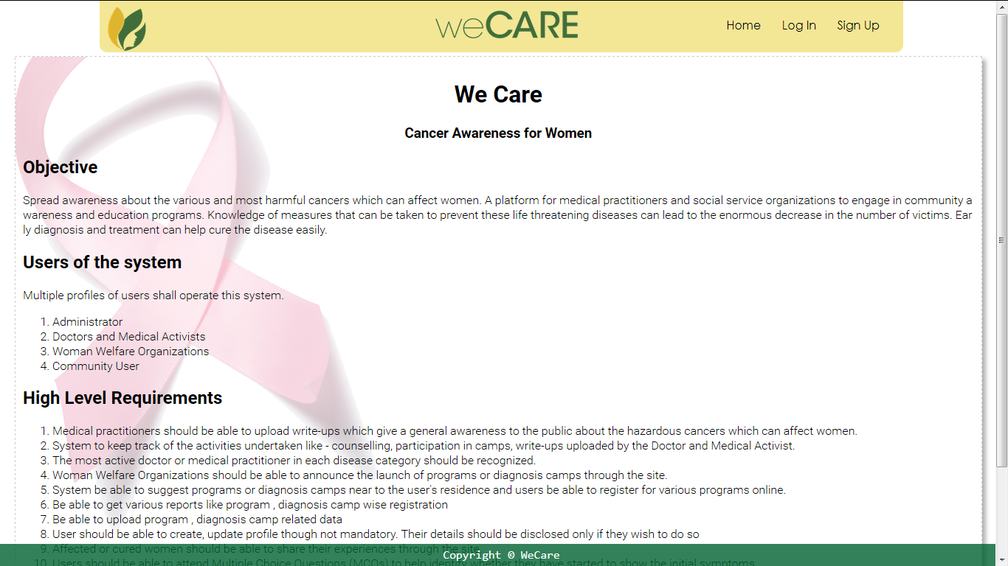
Welcome Screen

Slide 11
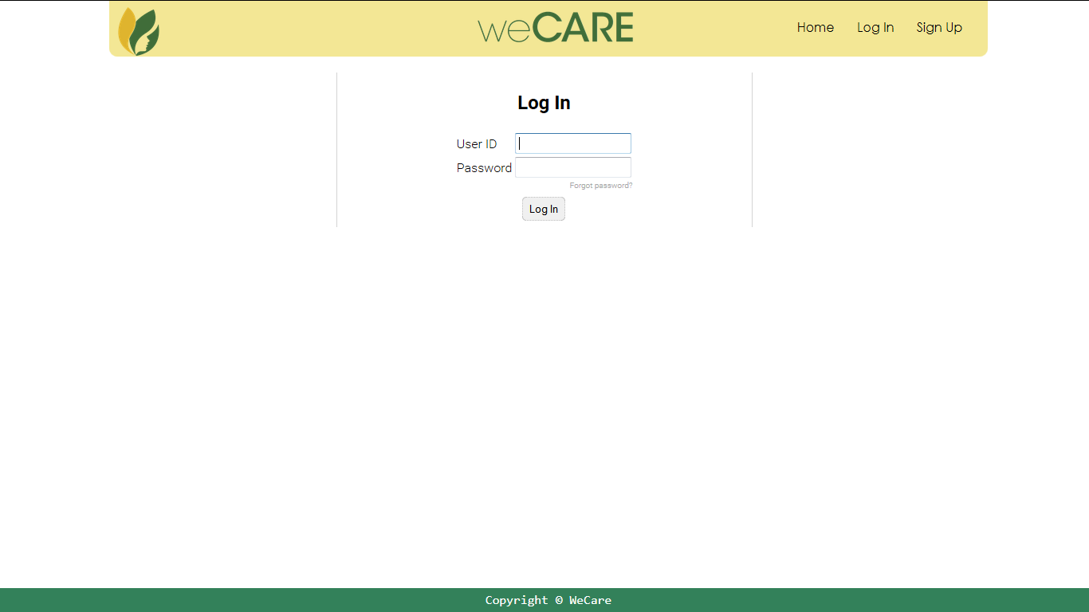
Login Screen

Slide 12
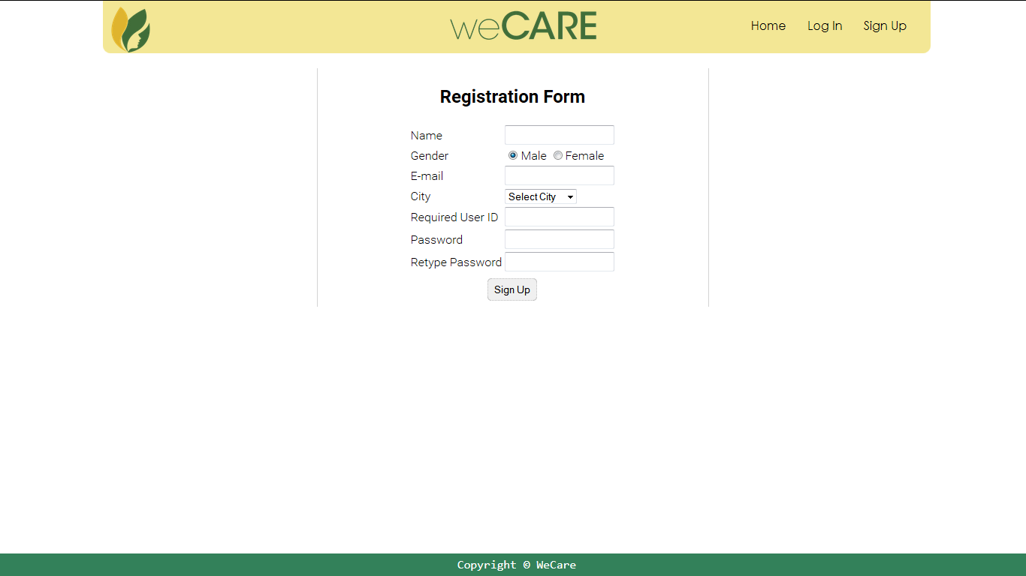
Signup Screen

Slide 13
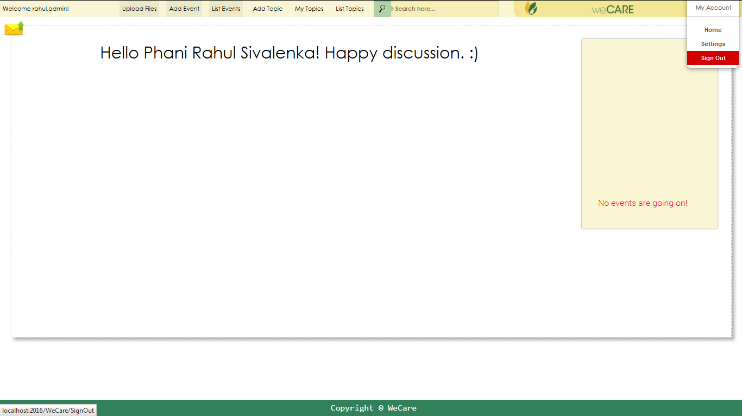
Logged-in – Administrator

Slide 14
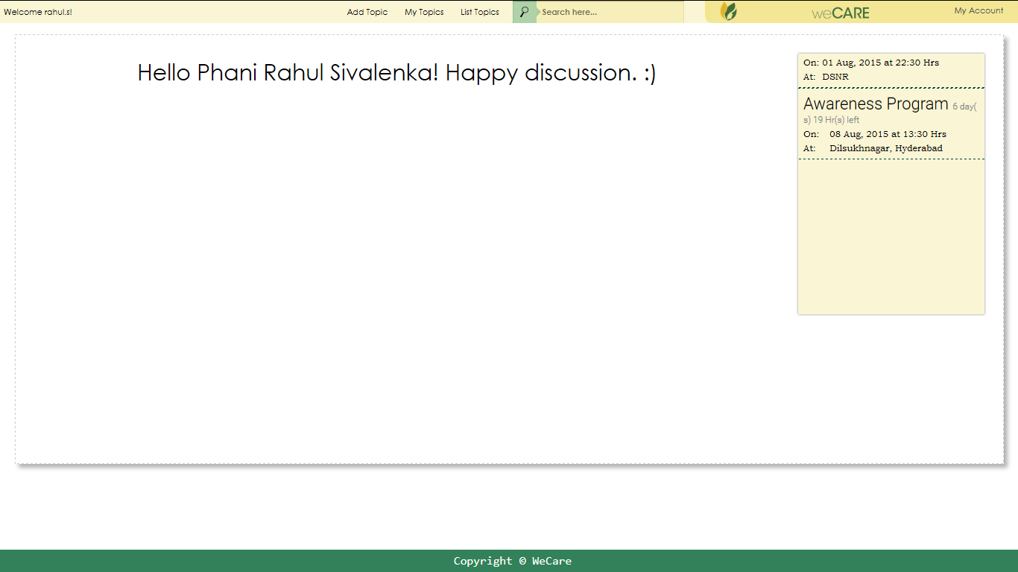
Logged-in – Community User

Slide 15
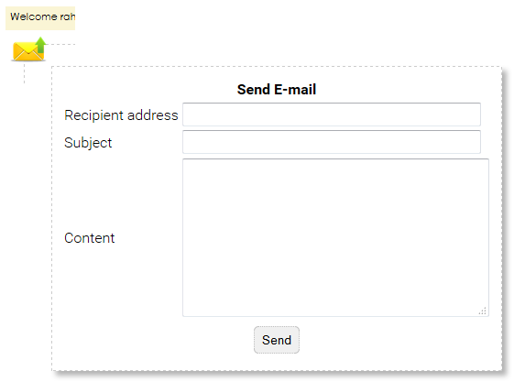
Send E-mail - Admin

Slide 16
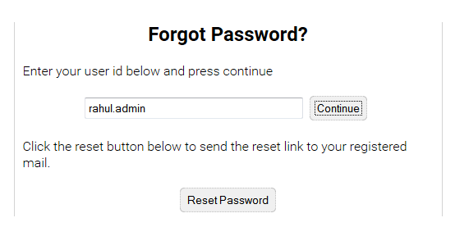
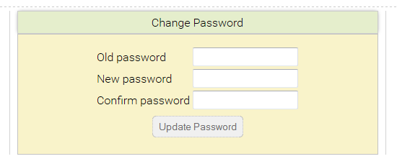
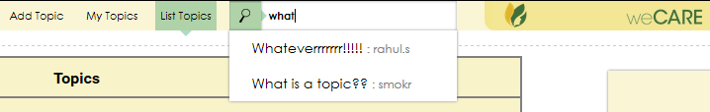
Forgot Password Change Password
Search Topic

Slide 17
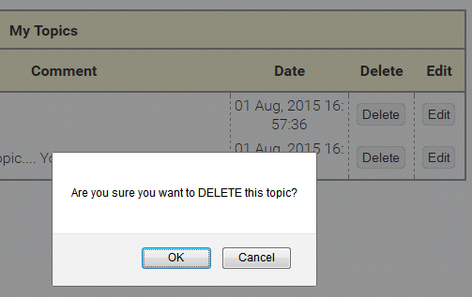
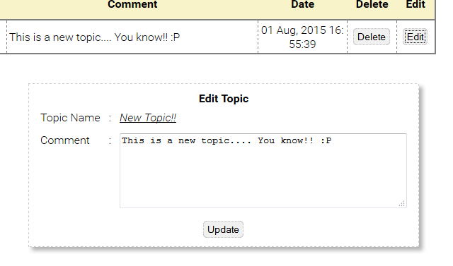
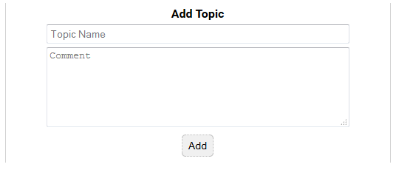
Add/Edit/Delete Topics

Slide 18
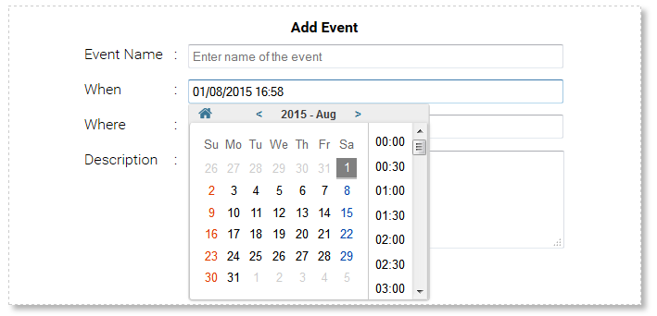
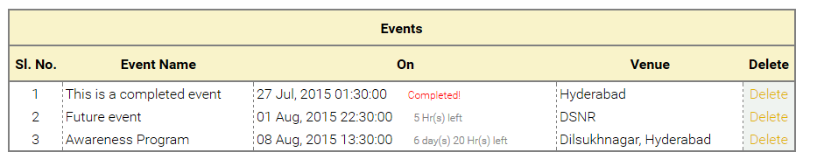
Add/Delete Events - Admin

Slide 19
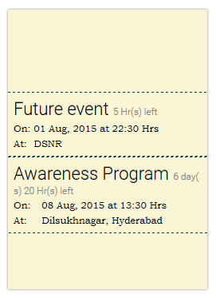
Events Marquee

Slide 20
References
http://docs.oracle.com/en/java/
http://www.w3schools.com/
http://jquery.com/
stackoverflow.com/

